Slide 1




Slide 2



Problems Faced by University Freshers
A Survey Report and Analysis

Slide 3

Submitted in partial fulfillment of the requirements for AICT.
Instructor: Miss Ramsha Khalid
Date of Submission: November 20, 2025
University of Engineering and Technology, Lahore

Slide 4

Group Members
Saad Mahmood
Muhammad Hamza Qamar
Malik Aliyan Zawar
2025-CS-123
2025-CS-166
2025-CS-120
Muhammad Abdullah Siddique
Muhammad Sheharyar
Abdul Hannan
2025-CS-130
2025-CS-154
2025-CS-121

Slide 5

Introduction
Starting university is an exciting yet challenging experience. Freshers face numerous difficulties during this transition that can affect their academic performance, emotional well-being, and social adjustment.
This report aims to identify and analyze the common problems faced by first-year students, including:
•
Academic Stress & Workload
•
Accommodation & Homesickness
•
Time Management Challenges
•
Social & Environmental Adjustment
Data was gathered via a survey of University students to understand their experiences.

Slide 6
Presentation Agenda
01
02
03
Introduction
Survey Overview
Key Observation 1
Setting the context for the challenges freshers face.
Methodology and scope of the data collection.
Analysis of major problems distribution among freshers.
04
05
06
Key Observation 3
Findings and Discussion
Key Observation 2
Context of prior academic performance as a baseline.
Analyzing the root causes and implications of the survey results.
In-depth analysis of student stress levels.
07
Conclusion & Suggestions
Recommended actions for supporting freshers and improving their university experience.

Slide 7






Survey Overview & Methodology
Scope
Method
Key Areas
Survey titled "University Fresher Problem Report" was conducted to analyze common issues for first-year students at Universities
More than 30 responses were gathered using Google Forms, ensuring a variety of feedback from different departments and backgrounds.
Concerns were primarily grouped into social/academic adjustment, workload, time management, and accommodation.

Slide 8
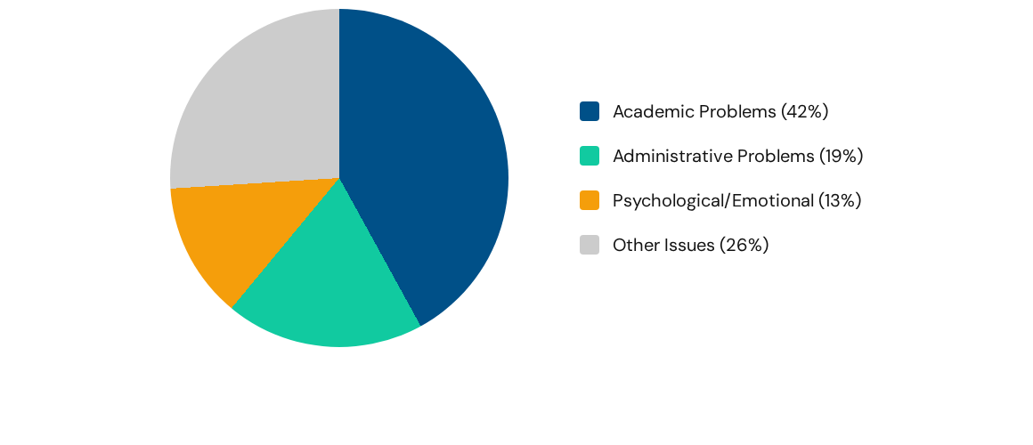
Key Observation 1: Major Problems
Other Issues
Academic Problems
Emotional
Administrative problems
Academic problems are the single largest challenge (42%), followed by administrative issues (19%) and emotional stress (13%). These three account for 74% of all reported major issues.

Slide 9
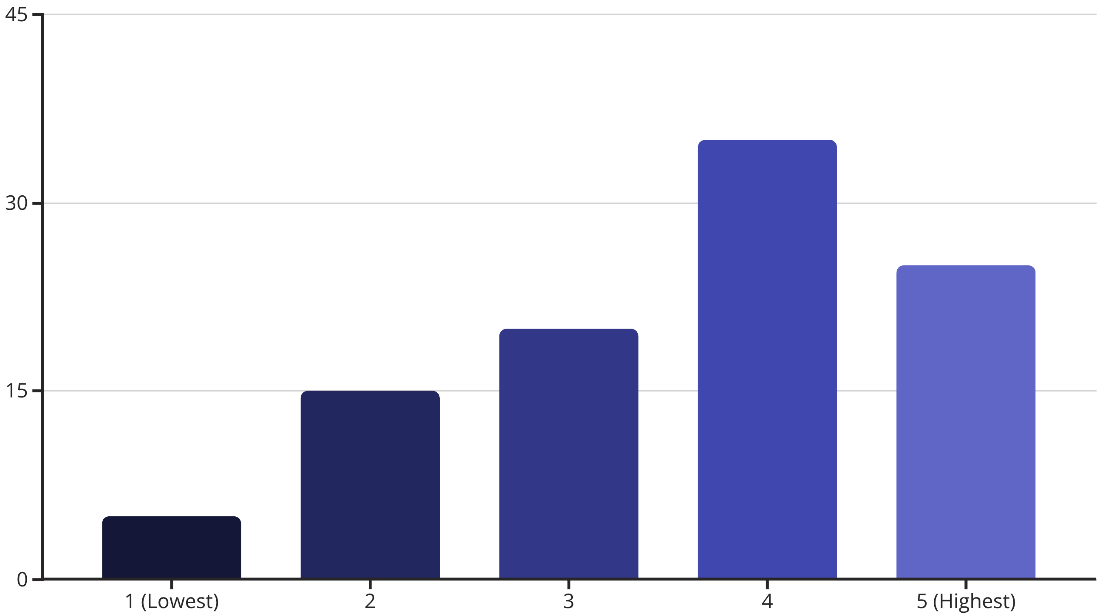
Key Observation 2: Stress Levels
A significant 60% of freshers report high to extreme stress (Levels 4 & 5). This indicates poor well-being and is likely a direct consequence of academic and administrative pressures.

Slide 10
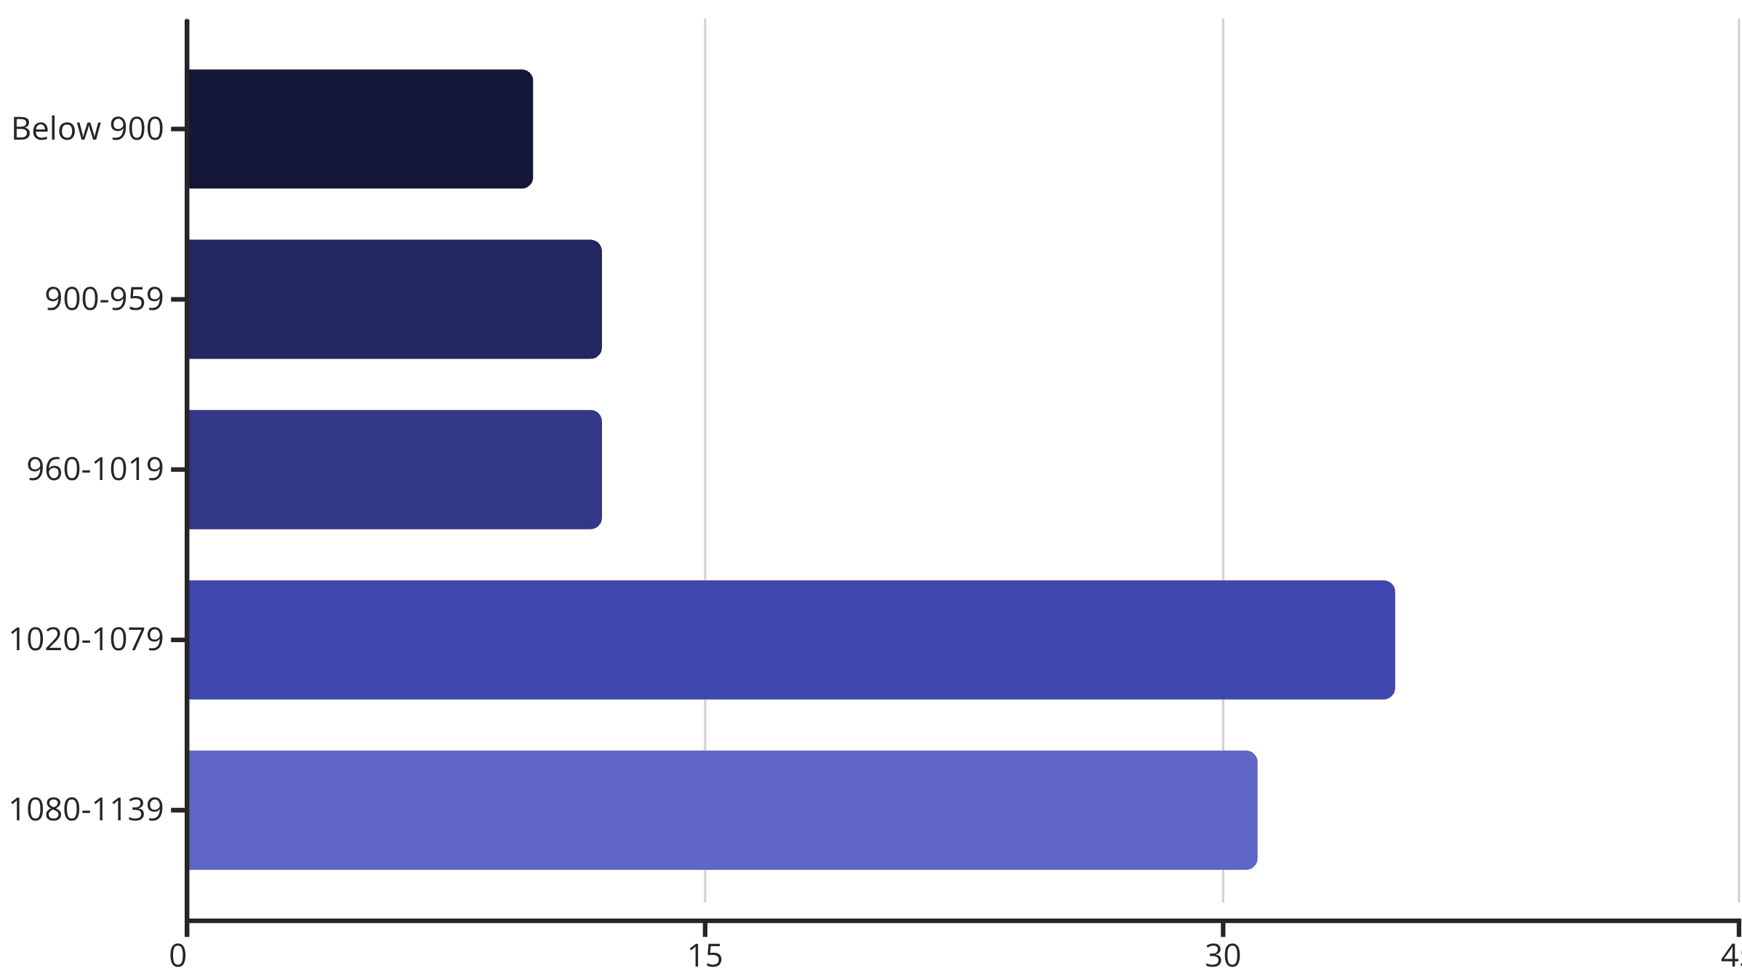
Key Observation 3: Academic Context
66% of the cohort scored 1020 or above in previous exams. This strong academic foundation suggests their struggles are not from lack of aptitude, but a gap in *academic transition*.

Slide 11


Findings and Discussion
Academic Overload:
Administrative Friction:
The volume and pace of coursework, coupled with a lack of clarity regarding assignment submission and assessment methods, constitute the single largest source of reported stress.
Frequent complaints regarding "University Management" and "Facilities" highlight operational inefficiencies that distract from learning. A lack of transparent communication regarding fees and schedules creates unnecessary anxiety.
Well-Being Crisis:
A significant percentage of freshers linked their problems to Psychological or emotional stress and Health and Lifestyle issues. This confirms the critical need for robust, accessible mental health and lifestyle guidance often neglected in the transition phase.

Slide 12
Suggestions
Reduce Course Load and avoid complex subjects not relevant to the student's career (e.g., MWM for Computer Engineering, CS, AI, CYS students).
Establish accessible counseling services and stress management workshops for mental well-being.
Provide proper academic guidance and time management training to reduce study pressure.
The University management and faculty must show some kind of leniency towards freshers as they struggle with the new environment
Communication between students and faculty should be improved.
Focus on physical activities for fitness and events for entertainment and prepare students about their career.
The university system must be updated and changed to facilitate students, as the current system is poor and lacks facilities.

Slide 13
Conclusion
“
The survey concludes that freshers struggle mainly due to academic overload and administrative inefficiencies, which together create high stress for about 60% of students. Since the cohort is academically strong, the institution should reduce structural barriers and provide support such as study-skills workshops and an improved campus environment to ease the transition.
”

Slide 14
Thank You

